Slide 1
Mission Statement Landing Page
Our mission is to transform an existing home into a world-class research laboratory and sustainable living showcase.

Slide 2
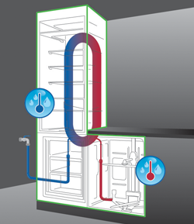
About Whirlpool Corp Sustainability
At Whirlpool, we are passionate about improving the quality of life for our consumers while minimizing our impact on the environment. And we are combining the power of innovation with our environmental commitment to create solutions that delight consumers – today and tomorrow.
Sustainability Video
http://vimeo.com/65311959
http://www.whirlpoolcorp.com/about/design/green_kitchen/default.aspx

Slide 3
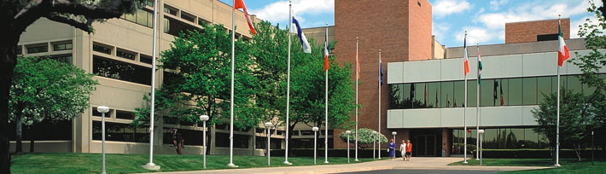
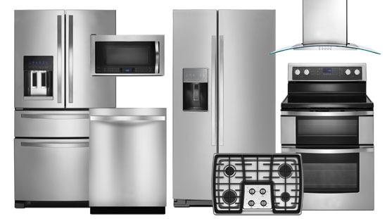
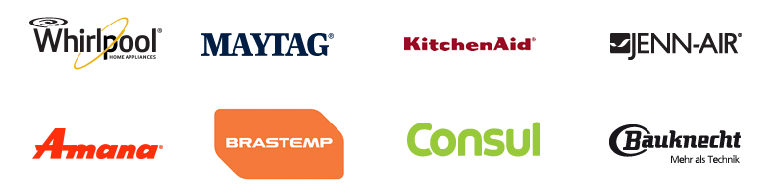
About Whirlpool Corporation
videos
http://www.whirlpoolcorp.com/2013annual/video-library.html

Slide 4

WERLD Program

Slide 5
The WERLD (Whirlpool Engineering Rotational Leadership Development) Program is a premier training program that has been developing world-class engineering leaders through challenging assignments, global team projects, integrated training and development, and formal coaching and mentoring programs. WERLD Engineers go through four 6-month rotations and after which they have the opportunity to pursue a technical Masters degree at Purdue University.
WERLD engineers have the opportunity to participate in the ReNEWW House program. Up to three WERLD engineers can live in the ReNEWW House while on campus and leverage the laboratory for their research.

